Slide 1

به نام هستی بخش
Hybrid Meta-Heuristics: LLM-Enhanced Particle Swarm Optimization
ارایه دهنده : محسن حامی
استاد درس : دکتر عباد زاده
درس بهینه سازی فرا ابتکاری
پاییز ۱۴۰۴

Slide 2
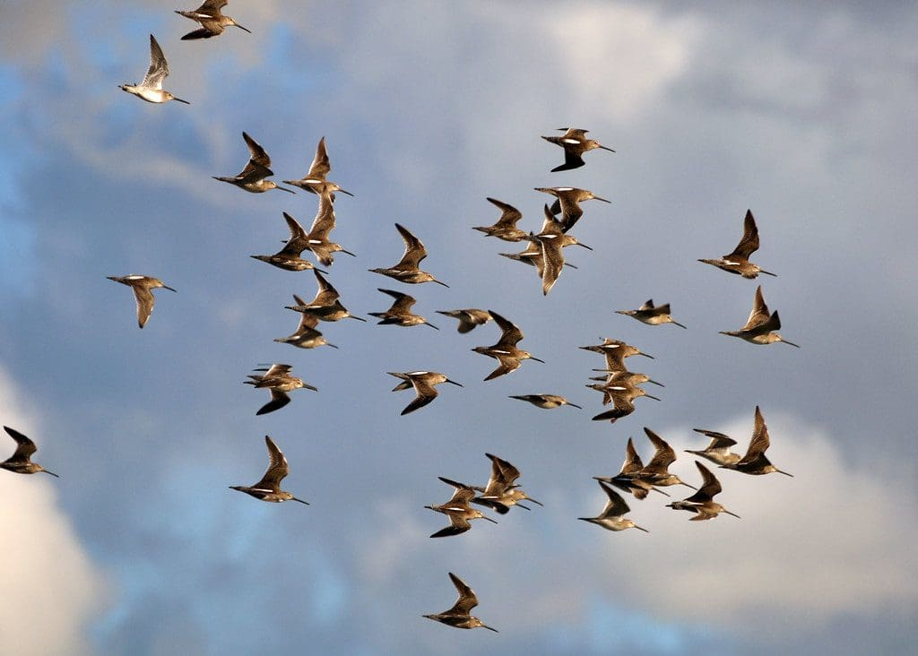

Introduction
Methods
Conclusion
Discussion and QA
References
What is Particle Swarm Optimization (PSO)?
The Analogy (The “Bird Flock”):
Imagine a flock of birds flying over a dark field looking for food.
None of the birds know exactly where the food is, but they know how close they are to it.
The Strategy: Each bird follows two simple rules:
Remember the best spot I have found so far (Personal Best).
Fly towards the best spot the whole flock has found so far (Global Best).
Eventually, the whole flock gathers around the food source.
2/15

Slide 3
Introduction
Methods
Conclusion
Discussion and QA
References
How PSO Works: Parameters & Trade-offs
The 3 Key Parameters (The “Knobs”):
Inertia Weight (w):
Definition: How much the particle keeps moving in its previous direction.
Effect: High w = Exploration (flying wildly). Low w = Exploitation (slowing down to search carefully).
Cognitive Coefficient (c1):
Definition: How much the particle trusts its own memory (pbest).
Effect: High c1 encourages independent exploration.
Social Coefficient (c2):
Definition: How much the particle trusts the swarm leader (gbest).
Effect: High c2 makes the swarm converge (cluster) quickly.
3/15

Slide 4
Introduction
Methods
Conclusion
Discussion and QA
References
✅ Pros: Simple to implement, works without complex math (derivatives), effective for discrete numbers (like number of layers).
❌ Cons: Can get stuck in “Local Optima” (finding a good spot, but missing the best spot), and the parameters (w,c1,c2)
Standard PSO often uses a fixed inertia (e.g., w=0.7).
If w is too high, the particles fly past the target and never land (Chaos).
If w is too low, the particles barely move and get stuck in the first hole they find (Stagnation).
4/15

Slide 5


Introduction
Methods
Conclusion
Discussion and QA
References
The Challenge: Hyperparameter Tuning:
The Context: Deep Learning models (CNNs/LSTMs) are “black boxes.”
The Problem: Choosing the wrong parameters (Layers/Filters) kills performance.
Current Methods:
Manual Tuning (Slow).
Grid Search (Expensive).
Standard PSO (Gets stuck in local optima).
5/15

Slide 6
Introduction
Methods
Conclusion
Discussion and QA
References
Our Solution: The Hybrid Approach
We combine Physics (PSO) with Reasoning (LLM).
Goal: Create an optimizer that doesn’t just “move randomly” but “thinks” about the search space.
Three Variants Tested:
Simple PSO.
Vanilla Improved PSO (Adaptive Inertia).
LLM-Enhanced PSO (Memory + CoT).
6/15

Slide 7
Introduction
Methods
Conclusion
Discussion and QA
References
Methodology: Improved PSO (The Baseline)
Based on IEEE & ScienceDirect Papers.
Feature 1: Adaptive Inertia (w): High exploration early (w=0.9), high precision late (w=0.4).
Feature 2: Niching: A “Lone Wolf” particle that ignores the group to preserve diversity.
Why? Makes the baseline algorithm much harder to beat.
7/15

Slide 8
Introduction
Methods
Conclusion
Discussion and QA
References
Methodology: LLM Integration
The Brain: GPT-OSS-120b GPT API.
Memory Module (RAG): We record the history of Best/Worst runs.
Chain-of-Thought:
Prompt: “Analyze the trends first… Then suggest.”
Prevents random guessing.
8/15

Slide 9
Introduction
Methods
Conclusion
Discussion and QA
References
Task 1: Regression (Air Quality)
Goal: Predict PM2.5 levels.
Model: Dynamic LSTM (Layers 1-6, Neurons 16-256).
Metric: RMSE (Lower is better).
Regression Results (Efficiency Win)
Improved PSO: RMSE 0.02145 | Time: 460s | Model: 6 Layers (Heavy)
LLM-Enhanced: RMSE 0.02159 | Time: 344s | Model: 2 Layers (Light)
Takeaway: The LLM found an equally accurate solution 25% Faster and using 3x less memory.
9/15

Slide 10
Introduction
Methods
Conclusion
Discussion and QA
References
Evidence of Reasoning (Regression)
Log Quote: “[LLM Analysis]: Performance is best around 3–5 layers… suggesting a sweet spot.”
The LLM explicitly told the swarm to stop looking at huge models, saving time.
Task 2: Classification (Waste Sorting)
Goal: Classify images as Organic vs. Recyclable.
Model: Dynamic CNN (Layers 1-4, Filters 16-128).
Optimization: Used 25% data subsampling for speed.
10/15

Slide 11
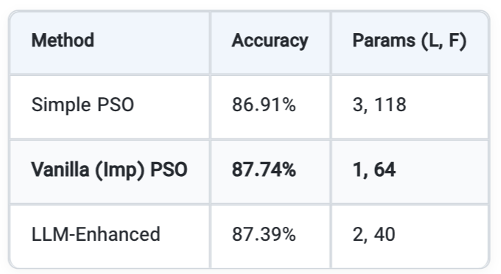
Introduction
Methods
Conclusion
Discussion and QA
References
Analysis of Classification Results
Simple PSO: Brute-forced a large model (3 Layers, 118 Filters). Good, but inefficient.
Vanilla PSO: The “Adaptive” nature found the simplest possible solution (1 Layer). Sometimes, simple is best!
LLM-Enhanced: Found a “Middle Ground” (2 Layers). Competitive, but slightly slower due to API calls.
Classification Results (Accuracy Table)
11/15

Slide 12
Introduction
Methods
Conclusion
Discussion and QA
References
LLM Behavior in Classification
Log Observation: “Replacing P4… Acc: 0.4481”.
The Risk: Sometimes the LLM suggests a “bad” move (Hallucination).
The Recovery: The Swarm mechanism corrected this in later iterations.
Lesson: Hybrid systems are robust; if the “Brain” fails, the “Physics” takes over.
12/15

Slide 13
Introduction
Methods
Conclusion
Discussion and QA
References
Summary: Architecture Discovery
Simple PSO: Always favors Big Models (Layers 3-6).
Vanilla PSO: Can find Ultra-Simple Models (Layer 1) if they work.
LLM-Enhanced: consistently finds Balanced Models (Layer 2).
Visual: A chart showing “Average Layer Count” for each method.
When to use which?
Use Vanilla Improved PSO: For simple problems where speed is critical and mathematical precision is enough.
Use LLM-Enhanced PSO: For complex, “Black Box” problems where training is very expensive (hours/days). The LLM’s ability to prune the search space early saves massive compute time.
13/15

Slide 14
Introduction
Methods
Conclusion
Discussion and QA
References
Conclusion
We successfully integrated Generative AI with Swarm Intelligence.
Key Achievement: Reproduced state-of-the-art results on two different domains (Time-Series & Vision).
Final Thought: The future of optimization is not just “Faster Math,” but “Semantic Understanding” of the optimization landscape.
14/15

Slide 15
thank for your attention QA
Introduction
Methods
Conclusion
Discussion and QA
References

Slide 16
References : S. Hameed, B. Qolomany, S. B. Belhaouari, M. Abdallah, J. Qadir and A. Al-Fuqaha, "Large Language Model Enhanced Particle Swarm Optimization for Hyperparameter Tuning for Deep Learning Models," in IEEE Open Journal of the Computer Society, vol. 6, pp. 574-585, 2025, doi: 10.1109/OJCS.2025.3564493. A. Nickabadi, M. M. Ebadzadeh and R. Safabakhsh, "DNPSO: A Dynamic Niching Particle Swarm Optimizer for multi-modal optimization," 2008 IEEE Congress on Evolutionary Computation (IEEE World Congress on Computational Intelligence), Hong Kong, China, 2008, pp. 26-32, doi: 10.1109/CEC.2008.4630771. keywords: {Evolutionary computation;PSO;multi-modal function optimization niching;dynamic;DNPSO}, A. Nickabadi, M. M. Ebadzadeh, and R. Safabakhsh, “A novel particle swarm optimization algorithm with adaptive inertia weight,” Applied Soft Computing, vol. 11, no. 4, pp. 3658–3670, Jun. 2011, doi: 10.1016/j.asoc.2011.01.037.
Introduction
Methods
Conclusion
Discussion and QA
References

